Slide 1


Pilmapres 2024
ElderCare Plus: Smart Bracelet Berbasis Internet of Things (IoT) Sebagai Solusi Pemantauan Kesehatan Lansia Secara Real Time di Panti Jompo Karya Kasih Medan
Universitas Sumatera Utara

Slide 2

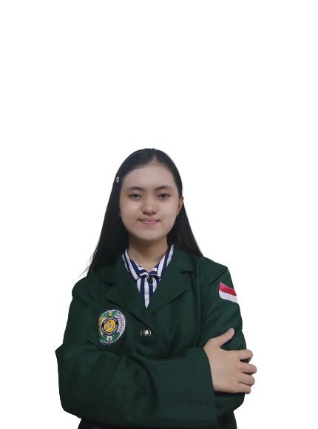
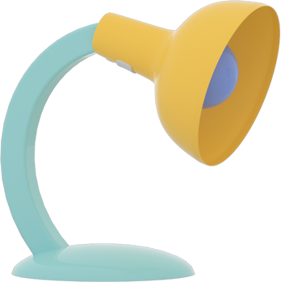
INTRODUCE!
Maria Anggraini Natio
Semester 6 - Information Technology - Universitas Sumatera Utara

Slide 3
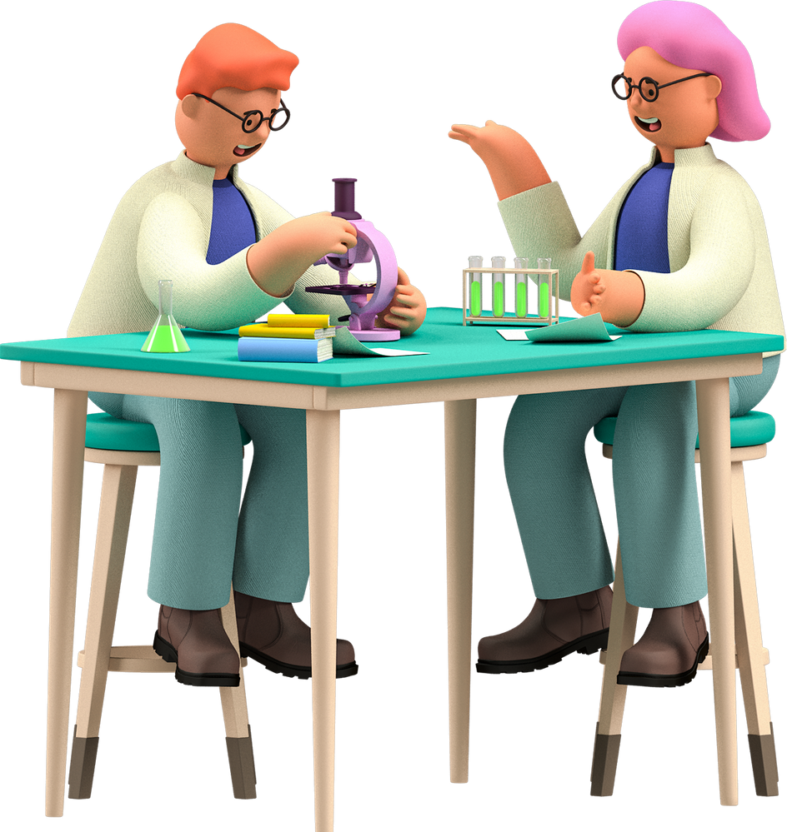
"Success does not belong to those who are smart. Success belongs to those who keep trying."
— BJ HABIBIE

Slide 4

Elderly
65+
11,75% => BPS (2024)

Slide 5
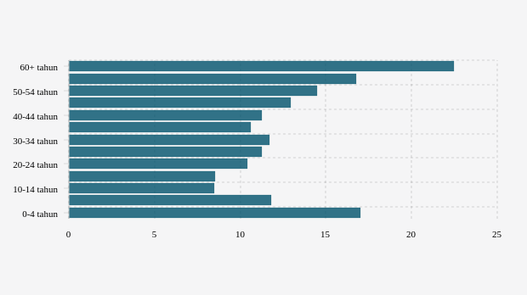
The health of the elderly is very important to be given further attention!
Databoks, 2021

Slide 6
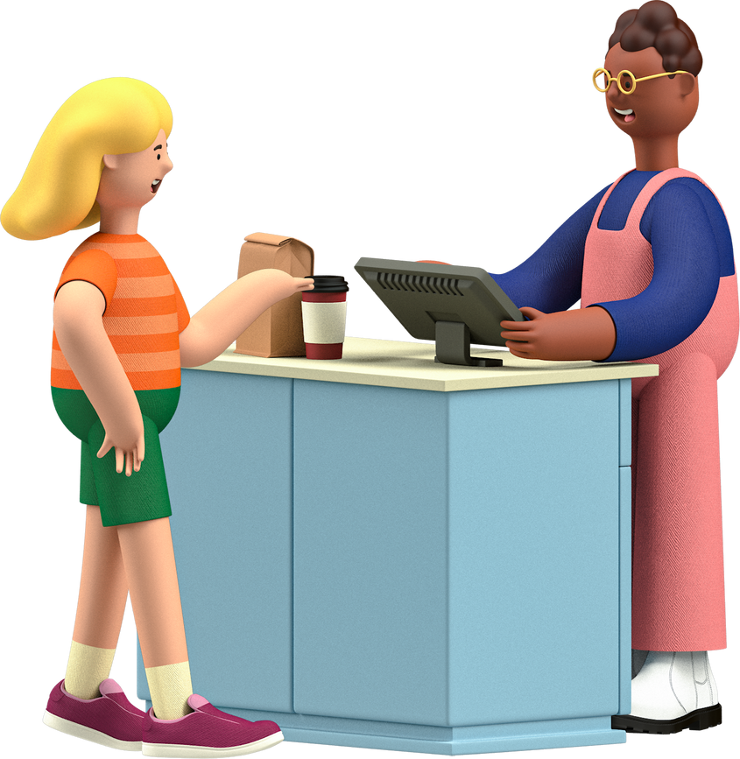
Why??
Body weakening, loneliness, feeling uncared for

Slide 7

There are still many cases of neglect of the elderly in Indonesia
2.4 million
BPS, 2019

Slide 8
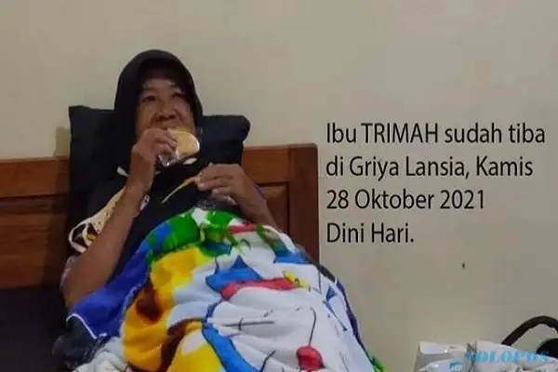
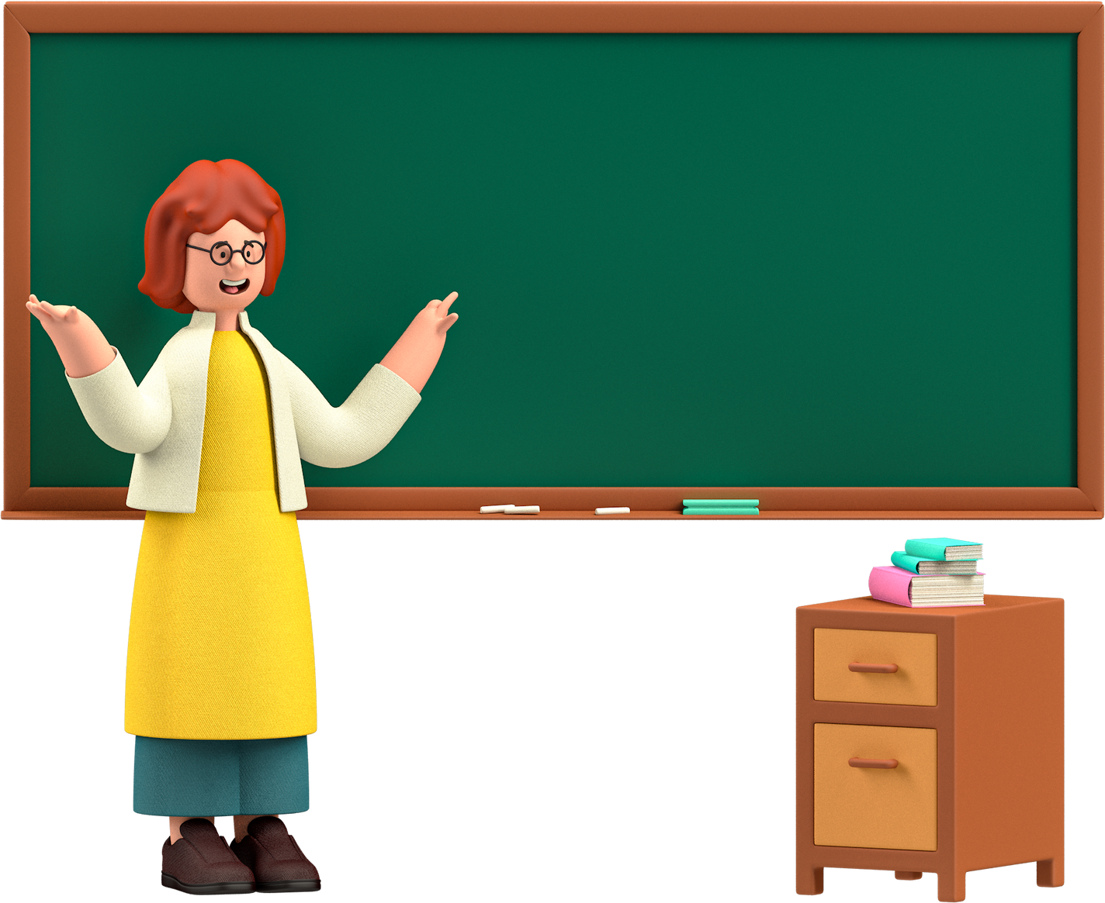
Case: An elderly woman from Magelang Regency, Central Java, was abandoned by her three children and placed in a nursing home.
Busy!

Slide 9
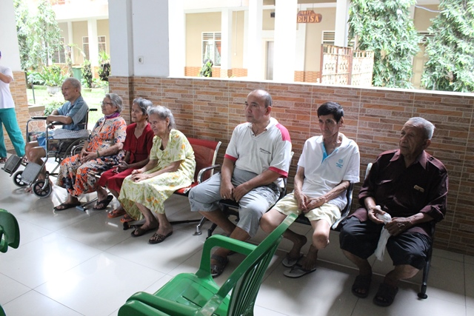
The same case can also be found in the Karya Kasih Medan nursing home.

Slide 10
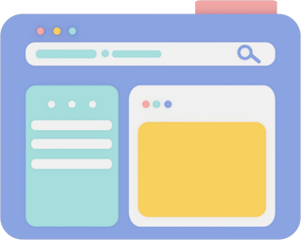
ElderCare Plus
(SDGs Poin 3)
A system that is useful for conducting health monitoring integrated with hospitals and elderly families, including heart rate, oxygen saturation, blood pressure, and cholesterol in real-time.

Slide 11
Real-time health monitoring identify potential health issues and take appropriate preventive measures especially chronic conditions.

Slide 12

Objectives
Monitor the health condition of elderly people in nursing homes in real-time.
Assists medical personnel and nursing home administrators making decisions in taking better care of the elderly
.
Provide health information to hospital and elderly families based on the graphical visualization results of the monitoring sensors

Slide 13

What’s IoT?

Slide 14
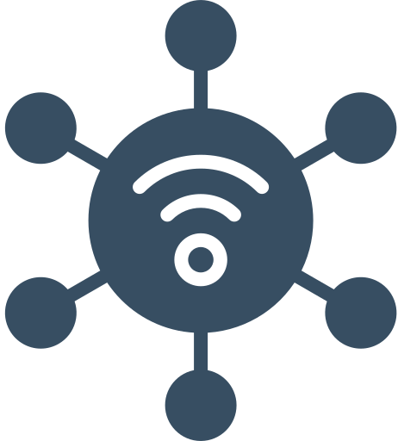

A COLLECTIVE NETWORK OF CONNECTED DEVICES, TECHNOLOGY THAT FACILITATES DATA EXCHANGE COMMUNICATION BETWEEN OTHER IOT DEVICES AND THE CLOUD.
Internet of Things (IoT)
MAKES HUMAN DAILY ACTIVITIES BECOME EASIER AND MORE EFFICIENT

Slide 15
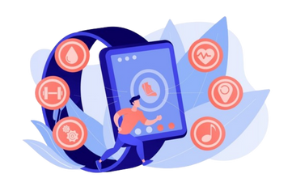
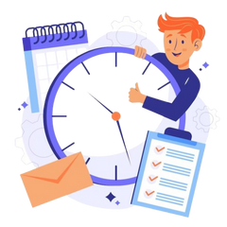
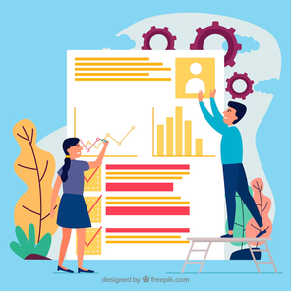
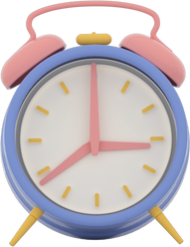
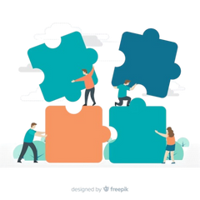
Advantages
The advantages of ElderCare Plus are as follows:
WEARABLE
REAL-TIME
EFFICIENT & FLEXIBLE
INTEGRATED WITH THE HOSPITAL AND ELDERLY FAMILIES
SAVE TIME

Slide 16
Methods
STEP 1
STEP 2
Identification of the problem
Data collection
bla,bla…
STEP 5
Testing and evaluation
STEP 3
STEP 4
Collaboration with related parties
Device design

Slide 17
Technology
Health indicator sensors
Gambar
List of technologies used
Blynk Apps
Gambar
Cloud VPS
Gambar
Artificial Intelligence (AI) -> Naive Bayes algorithm
Gambar

Slide 18

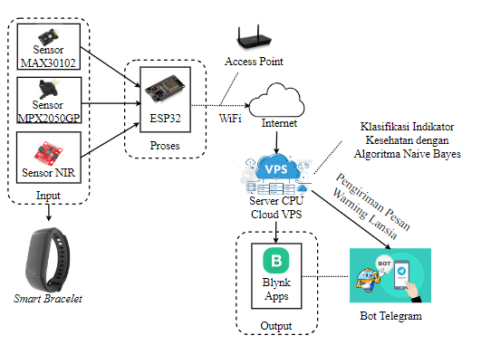
How It Works?

Slide 19
Conclusion
The results of designing this idea in the form of a tool are expected to help monitor the health conditions of the elderly at the Karya Kasih nursing home so that they get more efficient and timely health care.

Slide 20
Thank You!
Any Questions?

